Slide 1
Validating Concurrent Assessment and Design of Systems (CADS) – A Progress Update
Niles Guo Water & Energy Efficiency for the Environment (WE³ lab) Engineering & Public Policy Carnegie Mellon University nilesxug@andrew.cmu.edu

Slide 2
To review, CADS incorporate elements of other modeling techniques
CADS
Mathematical modeling of natural/physical systems
Expert input on system parameters, objectives, and non-numerical inputs
Iterative approach to cycle through potential scenarios
Co-located collaboration between experts
Include the effects of policies and regulations, and measure their societal impact

Slide 3
Understand where CADS fall in the literature
All Models
???
CADS
???
???

Slide 4
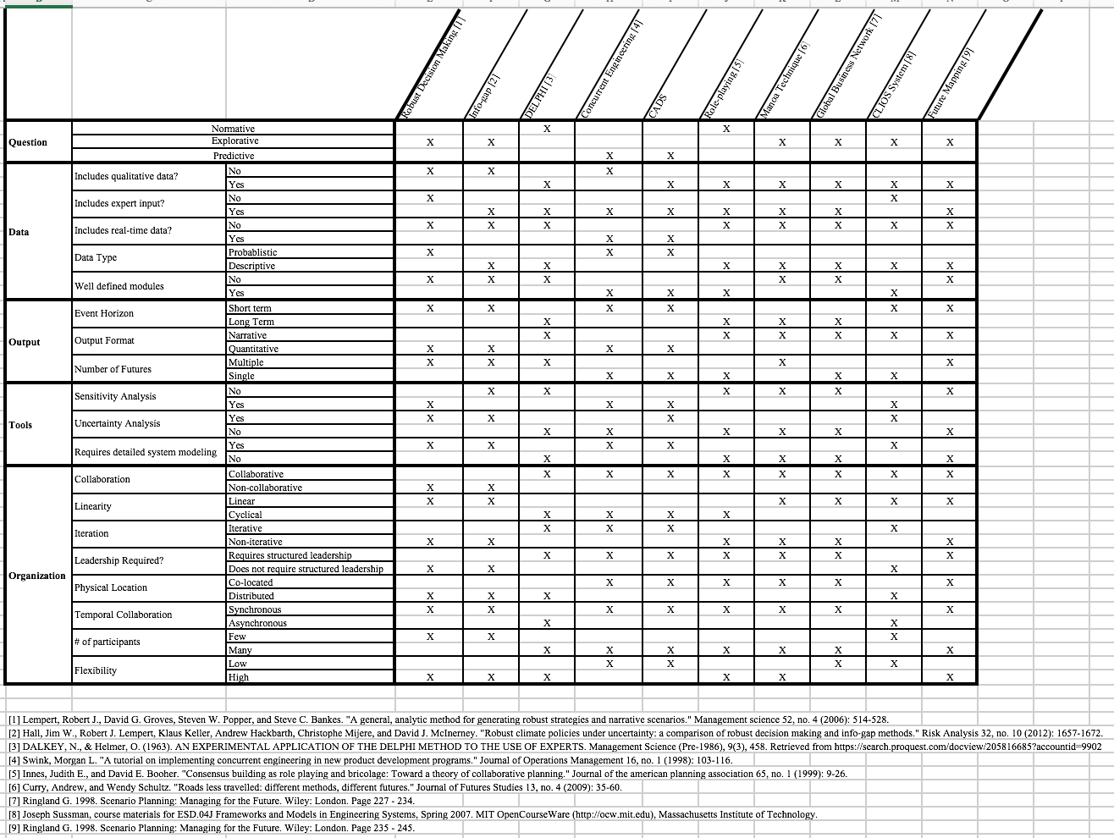

Slide 5
Next set of research questions
Internal consistency: do the results of CADS change significantly every time it is performed?
External consistency: do the results of CADS differ significantly against other comparable modeling techniques?
Historical consistency: do the results of CADS differ significantly when applied against historical case studies?

Slide 6
Next set of research questions
Internal consistency: do the results of CADS change significantly every time it is performed?
External consistency: do the results of CADS differ significantly against other comparable modeling techniques?
Historical consistency: do the results of CADS differ significantly when applied against historical case studies?

Slide 7
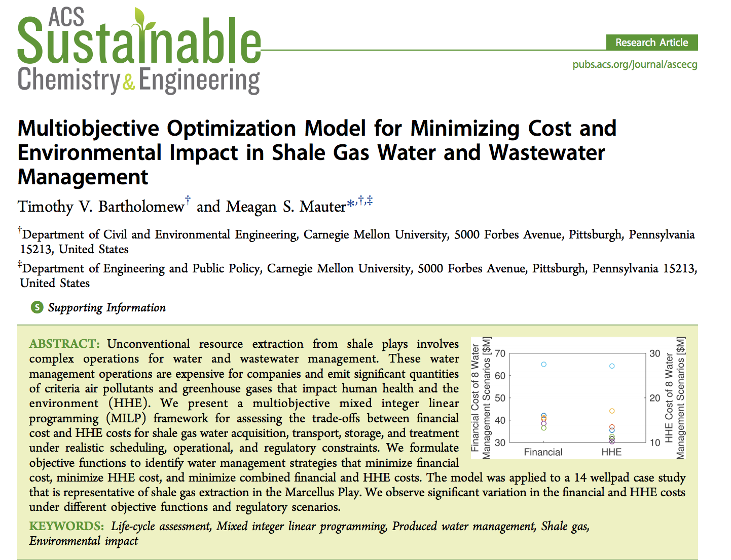
Case study

Slide 8
Research tasks
Identify the key decision makers and stakeholders for this scenario. This will help to tease out the submodules required for this case study.
Iterating with Tim, design and build each of the submodules for this particular CADS model.
Create profile cards with the relevant information for each of the stakeholder roles.

Slide 9
Research tasks continued
In January, using students from Meagan’s Environmental Engineering class, run 3-5 design sessions.
Compare the results of the design sessions with each other and with the overall global optimum identified in Tim’s paper.

Slide 10
Questions and feedback?

Slide 11
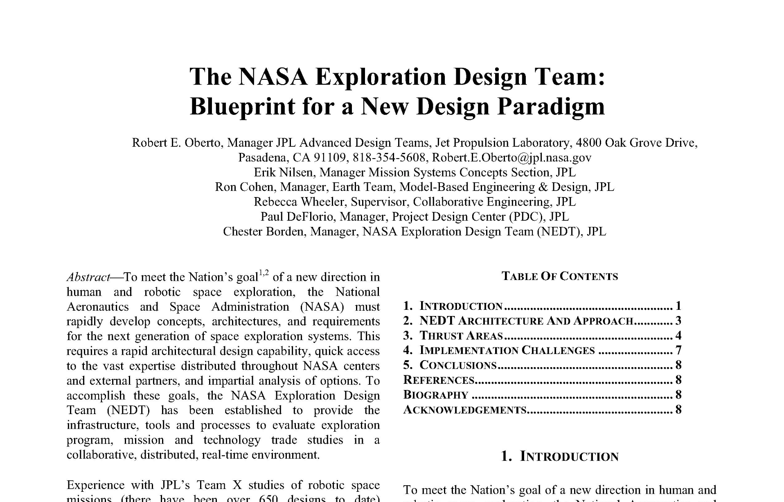
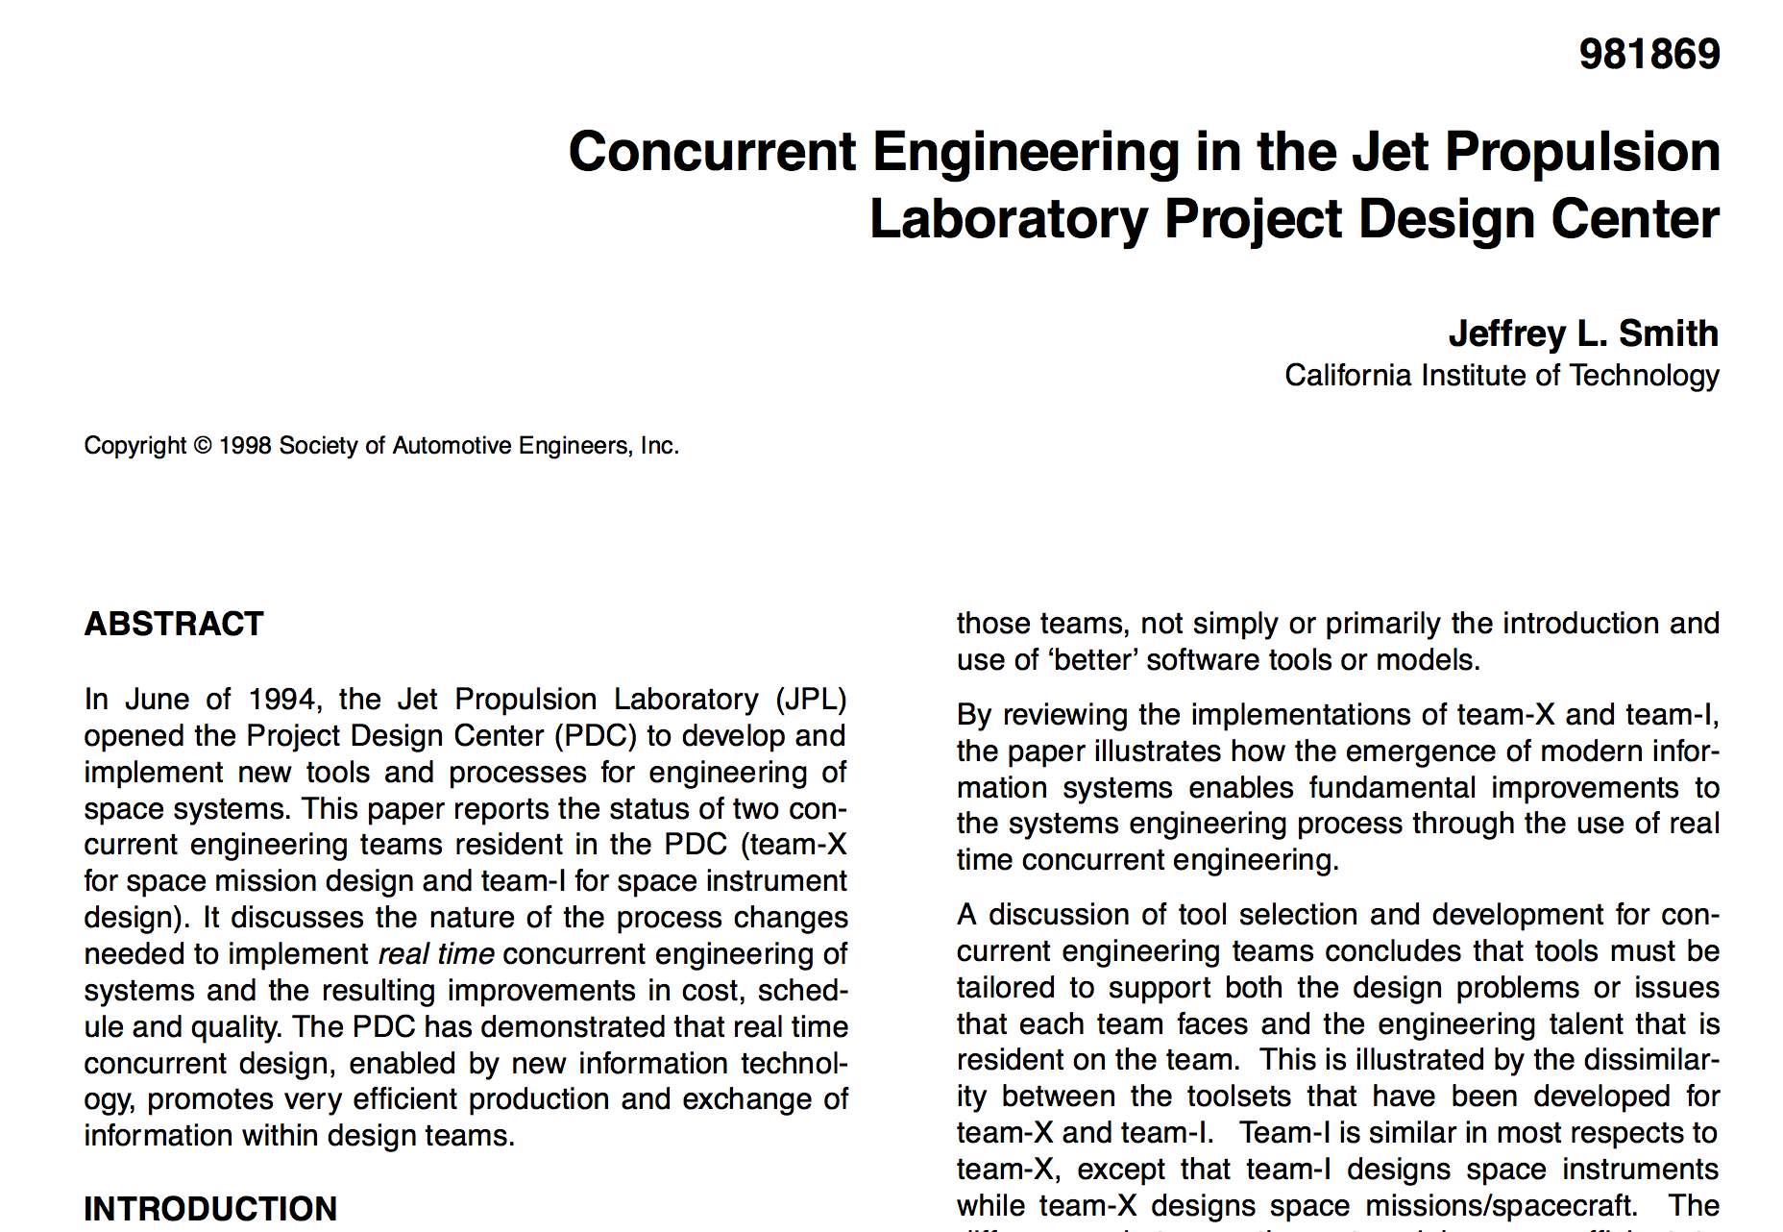
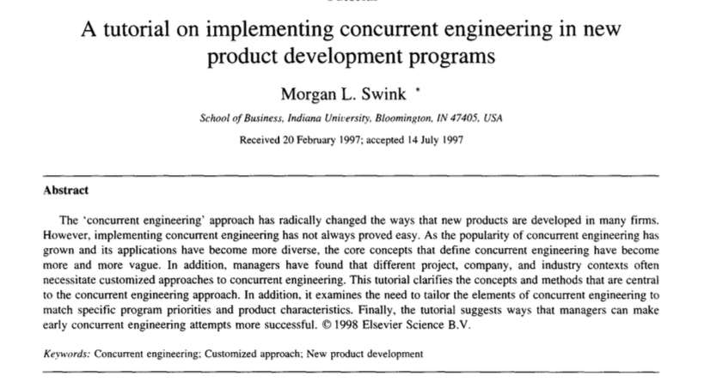
CADS leans on proven concurrent engineering concepts

Slide 12
Large scale projects are uncertain, complex, and have far-reaching impact
Energy Project
Air emissions
Soil quality
Water quality
Energy production
Human health impact
Income distribution
... and many more

Slide 13
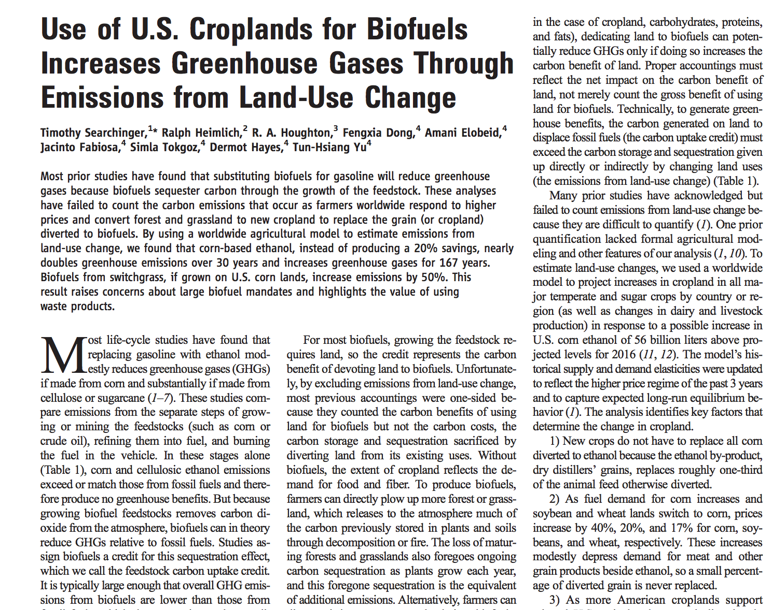
If poorly understood, these interactions can create negative spillover effects

Slide 14
Many existing models to tackle this issue
Normative
Role playing (MIT Climate Negotiation Game)
Expert elicitation
Explorative
Robust decision making (RDM)
Manoa technique
Predictive
Concurrent engineering
Mathematical modeling
Notes:
Normative models attempt to answer the question: What needs to be done in order to hit a certain target
Explorative models answer the question: what are the possible outcomes?
Predictive model answer the question: what is the final result, or what is the best scenario.

Slide 15
However, these models still have numerous drawbacks
Model | Drawback
Role playing/Expert elicitation | Relies on the credibility of the individual, prone to personal biases, sensitivity analysis difficult to perform
RDM/Manoa | Investigate robustness rather than the optimality, machine driven – misses black swan events
Concurrent engineering | Difficult to include non-numerical data, uncertainty difficult to include
Concurrent Assessment and Design of Systems

Slide 16
What is CADS?
Tomato Farm in Central California
Water resources
Land use
Water storage
Desalination
Economics
Energy storage
Environmental impact
Power
Notes:
CADS utilitizes an interconnected network of submodules, each designed with the knowledge of experts. Inputs of these submodules are then entered by a domain expert in that area in real-time and parallel, and the outcome is updated immediately. For example, in this particular case study, the objective is to maximize the profit of a tomato farm in central california.

Slide 17
Preparatory tasks
Identify appropriate case study to validate the CADS framework.
Through collaborative work sessions with experts, identify and design the individual submodules of the case study using Python, GAMS, Matlab, and/or Excel.

Slide 18
Research tasks
Using either volunteers or undergraduate students, run at least three sessions to ensure internal consistency.
Compare the results from CADS with the appropriate models to ensure external consistency.
Analyze the result from CADS with historical result to ensure historical consistency.
Notes:
test it out with Grad students and post docs

Slide 19
Once CADS is validated, further opportunity to:
Include local community as an active actor in the model.
“How do communities respond to large scale energy projects? Does the inclusion of community response to large scale energy project affect the validity of the modeling outcome?
Include social indicators as parameters, inputs, or objectives in the model.
“How to quantify the social effects of energy projects? Which social indicators are most informative to predict these social effects?”
Notes:
robert cavalier

